Slide 1
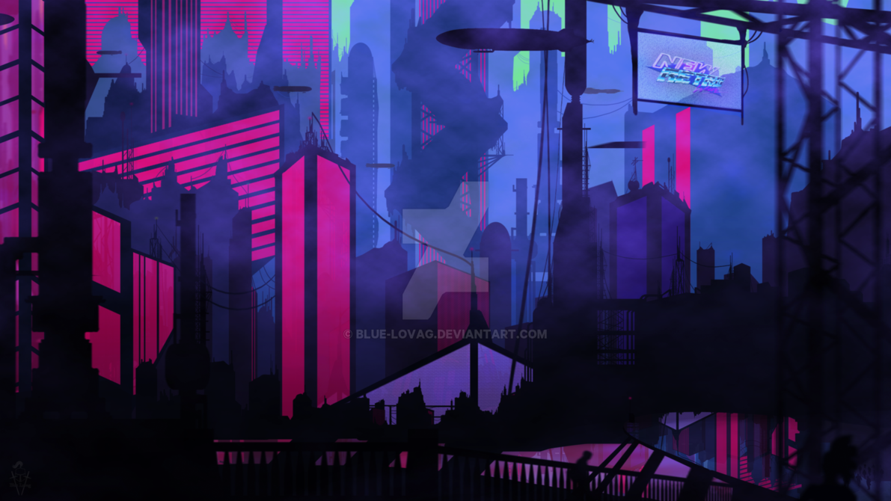
Soundsystem showdown
GROUP 17 Harry Leech, Ryan Flatt, Alix Roden

Slide 2
Initial ideas
Boxing game – A one tap boxing game where the player's objective is to knock out their opponent by jabbing them the fastest.
DJ DISKOFF – A rhythm game where the player could change the entire theme of the game by selecting one of the many genres in game. This idea would later evolve into Soundsystem showdown
Soundsystem Showdown – Our current project, soundsystem showdown will be an 80's inspired Retro-futuristic rhythm game where the player will perform songs across the vapourwave genre.

Slide 3
Target audience
Demographic:
Age: 12 - 25
Both Male and female
Casual mobile gamers
Psychographic;
Emergent service worker social class. Young, culturally affluent people who socialize with a broad range of people
Music enthusiasts with a slight interest in emerging experimental music genres.

Slide 4
CORE GAME MECHANIC
Players will be able to tap the screen to complete the note when prompted following the generated track. There will be multiple notes to hit depending on the difficulty.

Slide 5
THE GAME
A rhythm game for mobile devices inspired by the 80s and retro gaming
The game allows a player to select a song and a track is generated from this that they can follow, collecting powerups and matching the beat
There are various difficulty levels, that increase as the song progresses
There is a multiplayer mode where the players take it in turns on the same device to “battle” between each other for the highest score
Based on a 80s/modern retro revival theme
Game will be developed using Unity 2017 so that it is multi-platform and easy to develop

Slide 6
Meeting the BRIEF
2D Game
Our game will be designed from a 2.5D perspective, so there will be 3D parts such as the track but it will be displayed as 2D.
Main control mechanic is a simple tap
Players will be able to tap the screen to complete the note when prompted following the generated track. There will be multiple notes to hit depending on the difficulty.
Multiplayer – by taking turns
The number of players will be entered, and then the game will play the same song in turns and then display the high scores and the winners. There will be feedback whilst the player is playing so they can see how they are doing compared to the previous players.
On a single device
The game is designed to be played on one single phone/tablet/computer, there will be no networked multiplayer features
Symmetric
The games mechanic is to hit the notes based on the generated track, and gain a high score. This will increase in difficulty as the song progresses.
Simple and intuitive rules
The player has to hit the notes as displayed on the screen, there will be powerups for multiplying the note hits to increase the points gained. There are visual prompts for this, and when the song finishes a calculation of the high score will be shown to the player. This will not change, however different difficulties may have less or more powerups.

Slide 7
games from the brief
Toon Blast
Basic "puzzle solving" mechanic similar to candy crush, popular however the market is saturated with these type of games
One More Line
Features the "music" aspect similar to our game, however looks quite complicated
Badland
Nice graphics
Leap Day
Unique game mechanic, the level changes randomly every day and appears to be procedurally generated. This is similar to our idea of generating the levels based on the songs, so that the levels are different every time
One Tap Heroes
Appeals to a younger target market than we are aiming for due to the graphical style and gameplay
Tower of Babel
Competitive game mechanic, however is very simplistic but works for casual users, easy to identify who has the highest score

Slide 8
CHALLENGES
The algorithm for producing the randomized tracks from music will be difficult to code, however there are a lot of resources based on coding this in unity
The visuals will be hard to design so that they look futuristic
Time constraints

Slide 9
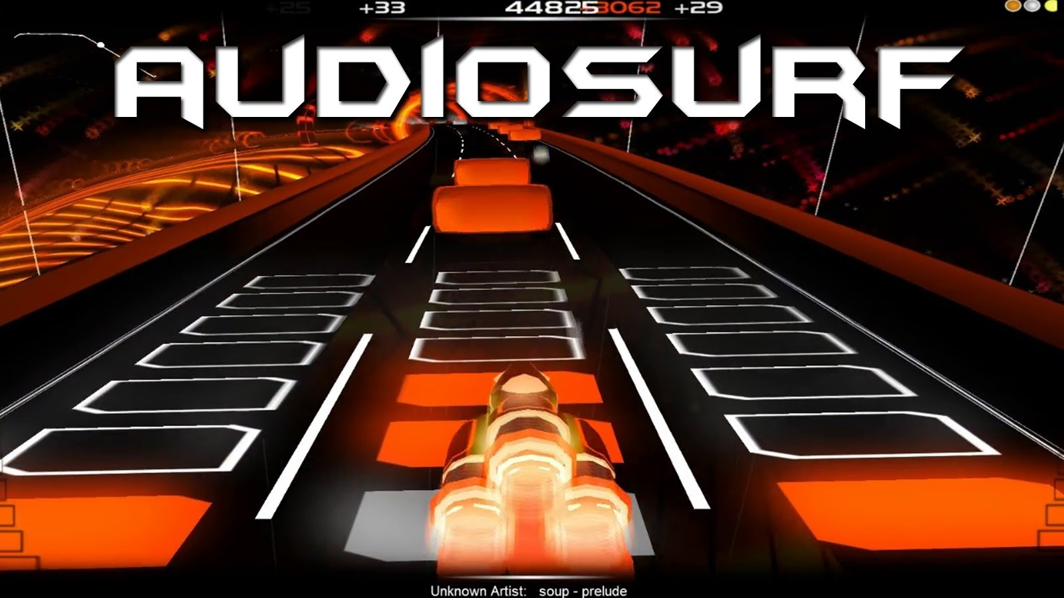
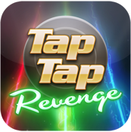
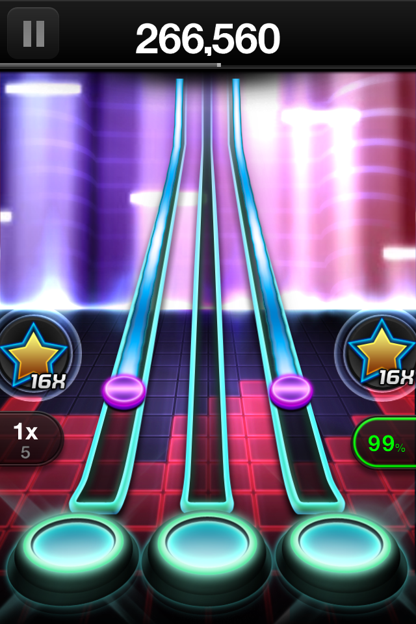
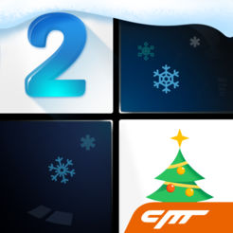
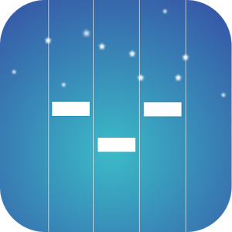
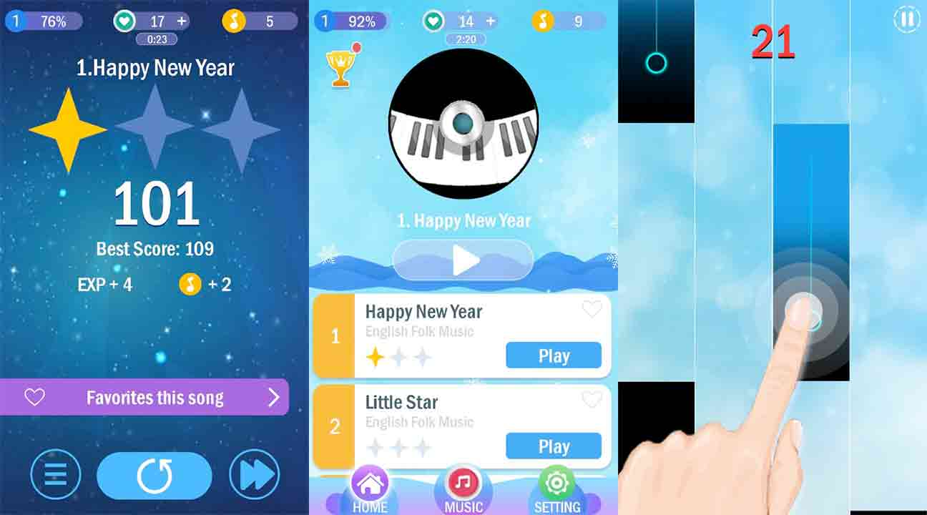
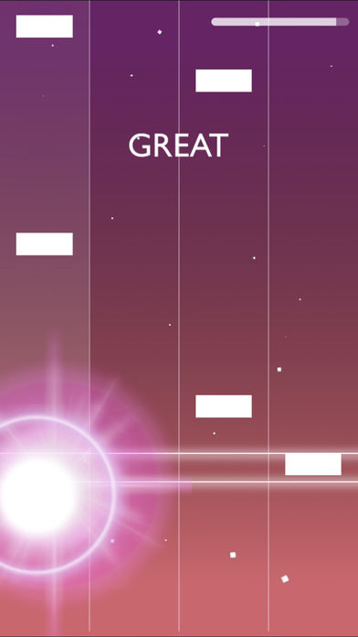
App inspiration
Piano Tiles
Melobeat

Slide 10
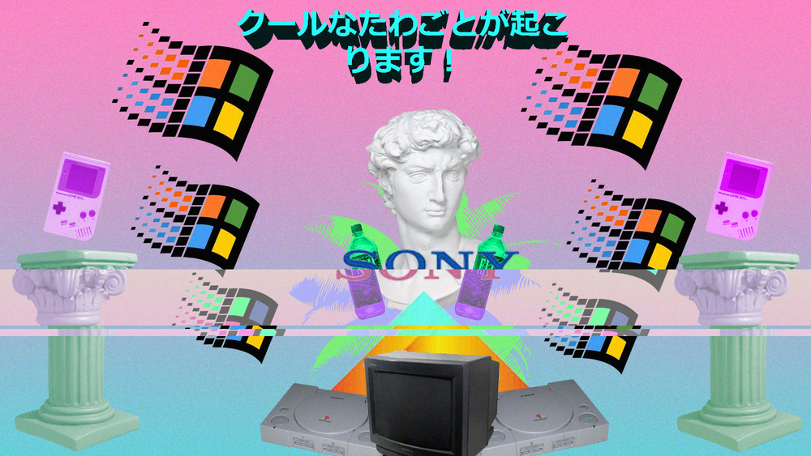
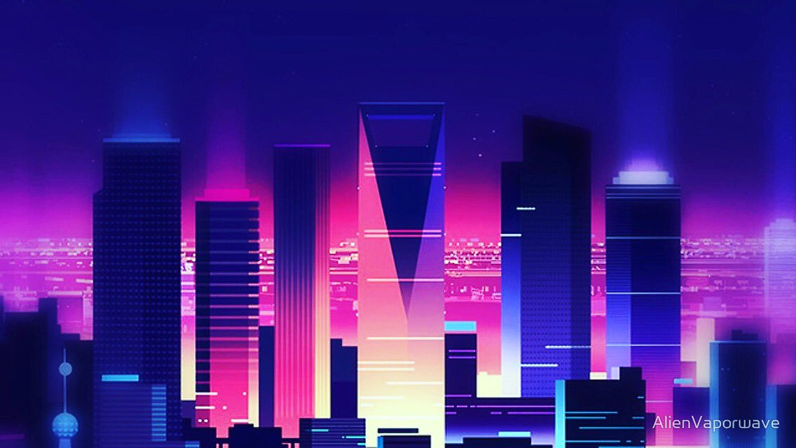
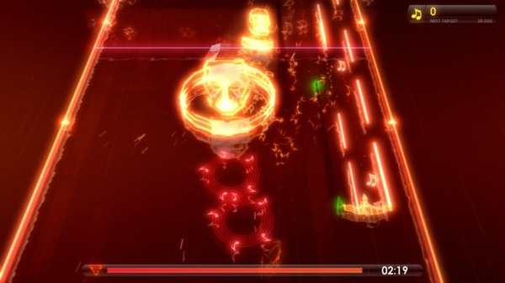
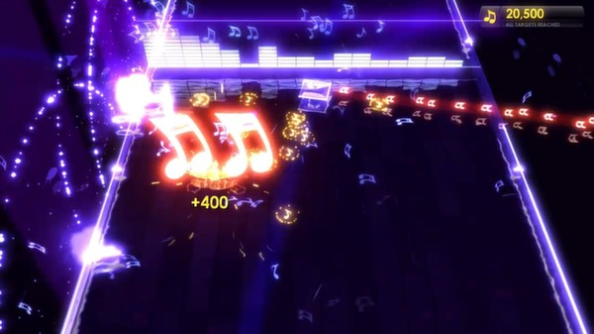
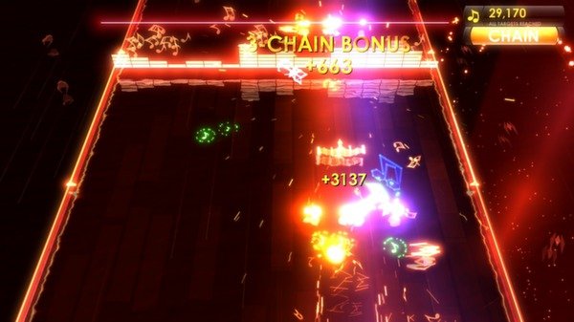
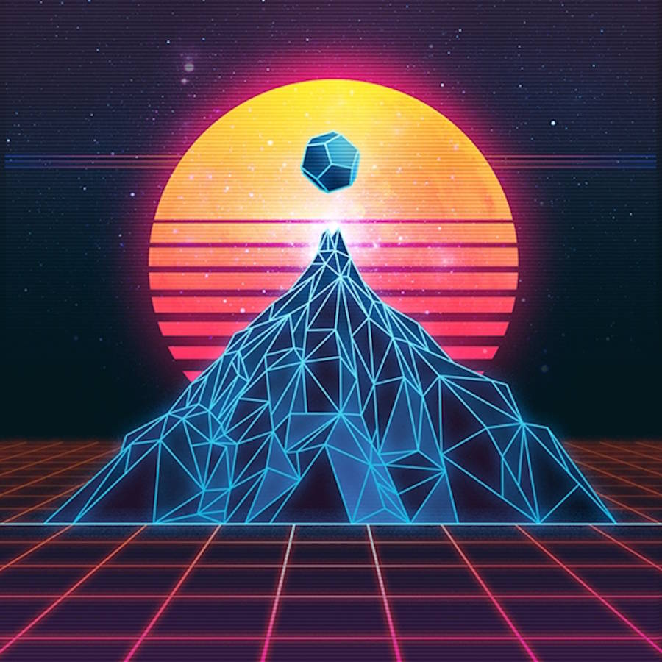
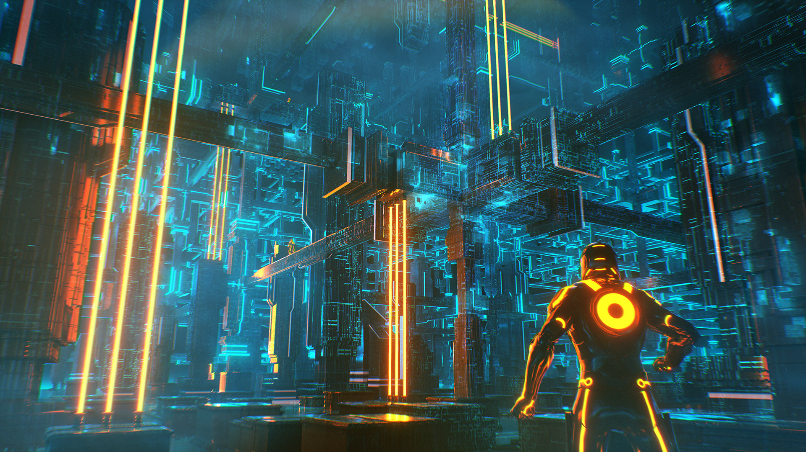
Colour scheme

Slide 11
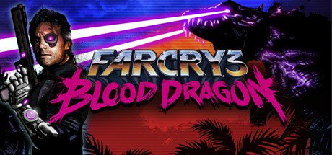
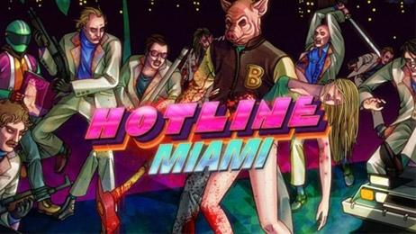
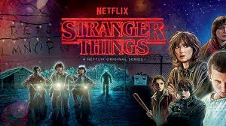
Design inspiration
TRON / 80s Retro
Vaporwave
80s Revival

